Slide 1
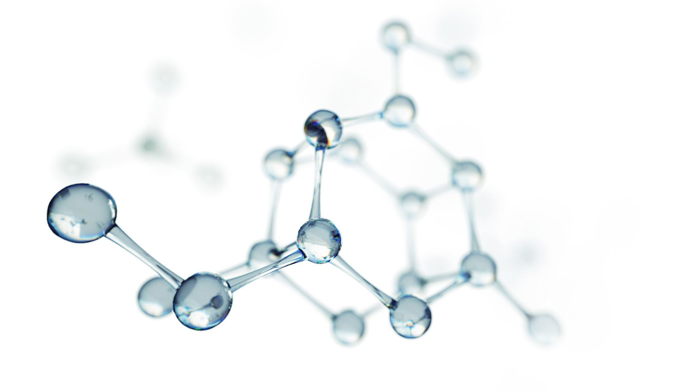
Analysis System for COVID19
Țica Miruna Carina Chileban Dragos-Andrei
Chivu Ștefan

Slide 2

Content
Introduction
Theoretical part
Practical part with ss
Conclusions

Slide 3
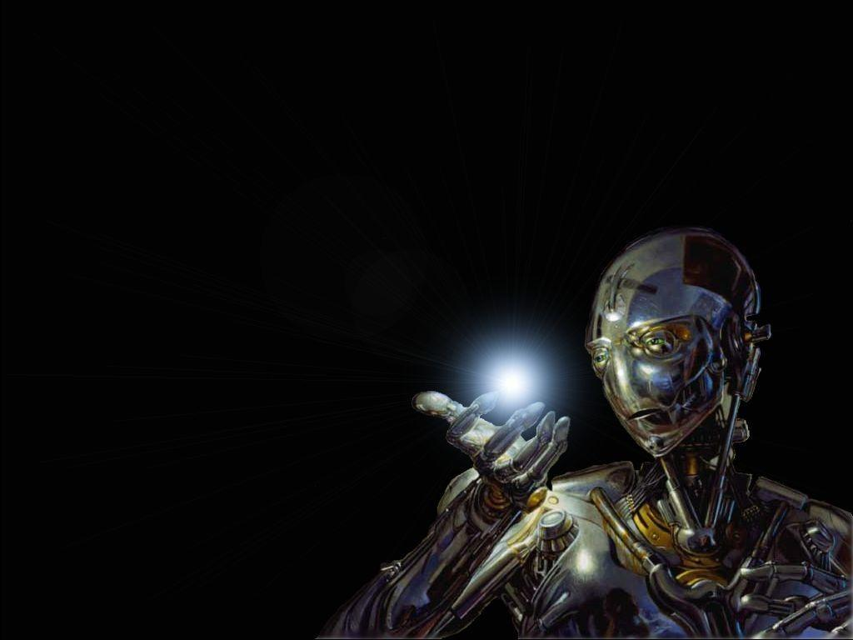
What we think AI is

Slide 4
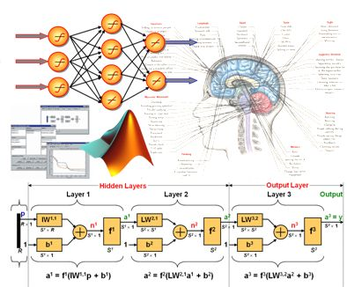
What the AI actually is

Slide 5

Introduction
Artificial intelligence (AI) is a technique that enables computers to mimic human intelligence. It includes machine learning.

Slide 6
Theoretical part
Deep learning is a subset of machine learning that's based on artificial neural networks. The learning process is deep because the structure of artificial neural networks consists of multiple input, output, and hidden layers. Each layer contains units that transform the input data into information that the next layer can use for a certain predictive task. Thanks to this structure, a machine can learn through its own data processing.
Machine learning is a subset of artificial intelligence that uses techniques (such as deep learning) that enable machines to use experience to improve at tasks. The learning process is based on the following steps:
Feed data into an algorithm. (In this step you can provide additional information to the model, for example, by performing feature extraction.)
Use this data to train a model.
Test and deploy the model.
Consume the deployed model to do an automated predictive task. (In other words, call and use the deployed model to receive the predictions returned by the model.)

Slide 7

Theoretical part
Random Forest
Random forests or random decision forests are an ensemble learning method for classification, regression and other tasks that operate by constructing a multitude of decision trees at training time and outputting the class that is the model of the classes (classification) or mean prediction (regression) of the individual trees.

Slide 8
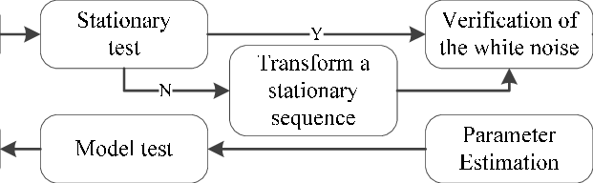
Theoretical part
ARIMA (Autoregressive Integrated Moving Average)
This model is fitted to time series data either to better understand the data or to predict future points in the series (forecasting). ARIMA models are applied in some cases where data show evidence of non-stationarity, where an initial differencing step (corresponding to the "integrated"part of the model) can be applied one or more times to eliminate the non-stationarity.

Slide 9
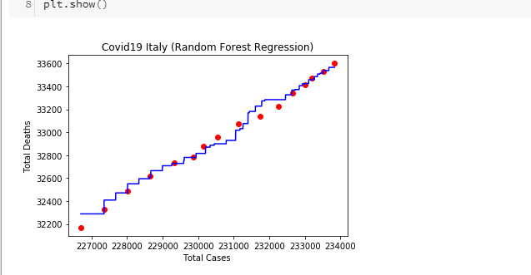
Practical part-Random Forest algorithm
Italy:
starting the forecast from 20.05.2020- June
accuracy 96%

Slide 10
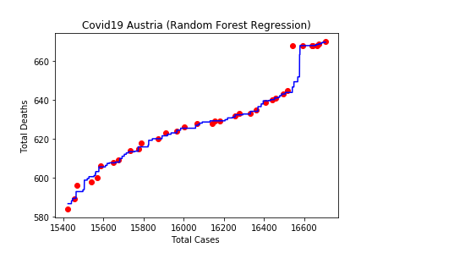
Practical part-Random Forest algorithm
Austria
From 01.03.2020- June
Accuracy:80.8%
Conclusion: could be improved

Slide 11
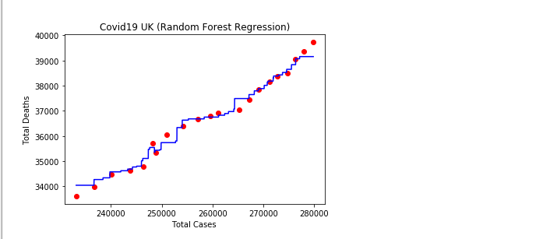
Practical part-Random Forest algorithm
UK
From 15.05.2020- June
Accuracy:96.9%

Slide 12
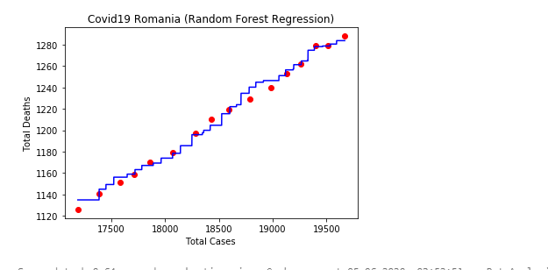
Practical part-Random Forest algorithm
Romania
From: 20.05.2020- June
Accuracy: 96.1%

Slide 13
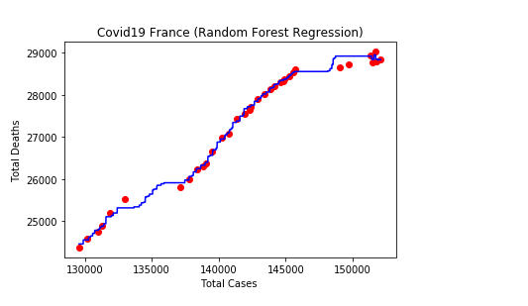
Practical part-Random Forest algorithm
France
From: 01.05.2020- June
Accuracy: 96.7%

Slide 14
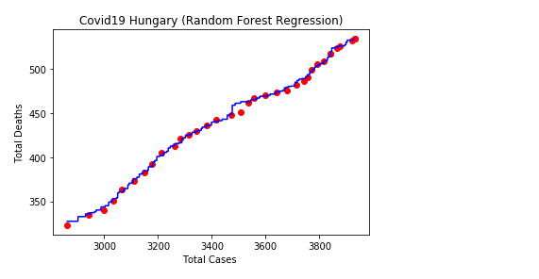
Practical part-Random Forest algorithm
Hungary
From: 01.05.2020-June
Accuracy: 97

Slide 15
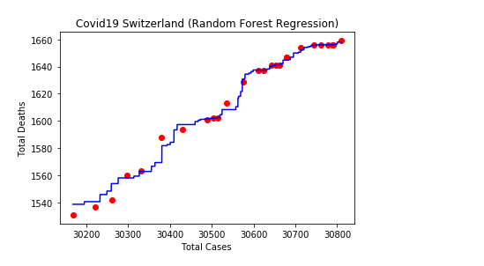
Practical part-Random Forest algorithm
Switzerland
From: 01.05.2020- June
Accuracy: 93.43%

Slide 16
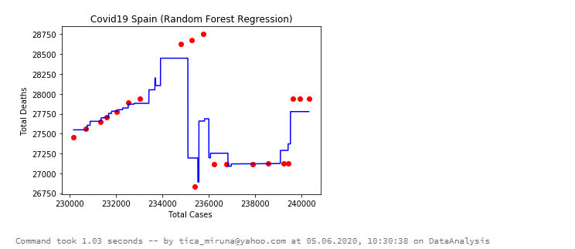
Practical part-Random Forest algorithm
Spain
Accuracy: low
Starting from May

Slide 17
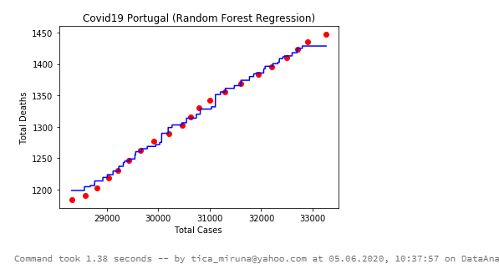
Practical part-Random Forest algorithm
Portugal
From 1st May-June
Accuracy:97.8%

Slide 18
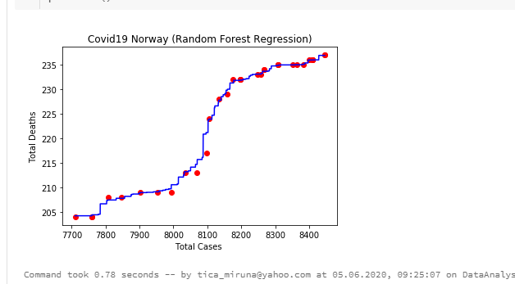
Practical part-Random Forest algorithm
Norway
From 1st of May till June
Accuracy:93.43%

Slide 19
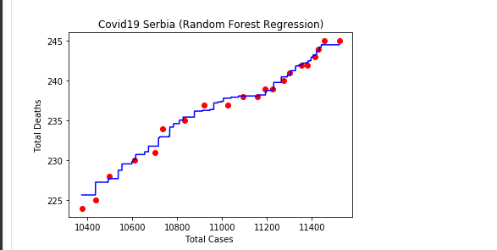
Practical part-Random Forest algorithm
Serbia
From 15th May – June
Accuracy:96.8%

Slide 20
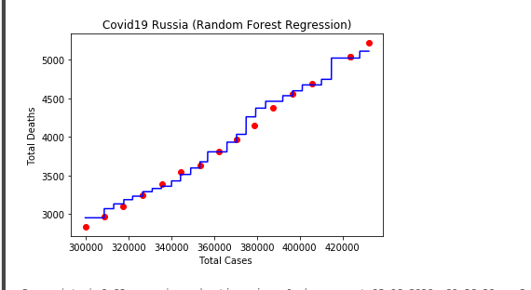
Practical part-Random Forest algorithm
Russia
From 1st May –June
Accuracy: 97.4%

Slide 21
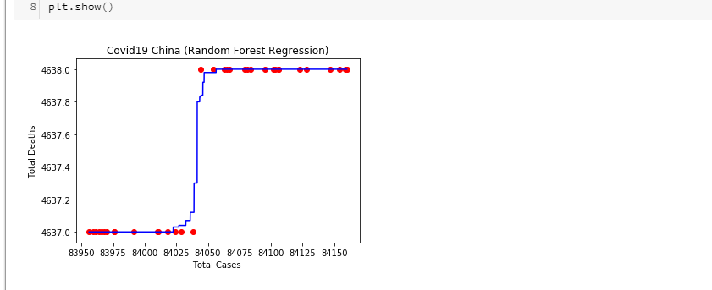
Practical part-Random Forest algorithm
China
From 1st May –June
Accuracy: 96.9%

Slide 22
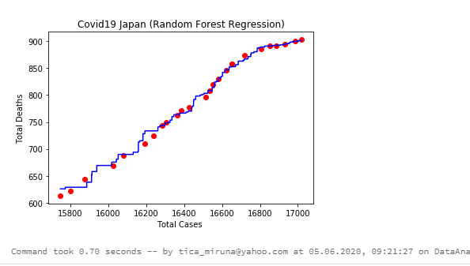
Practical part-Random Forest algorithm
Japan
From 15th May – June
Accuracy: 97.9%

Slide 23
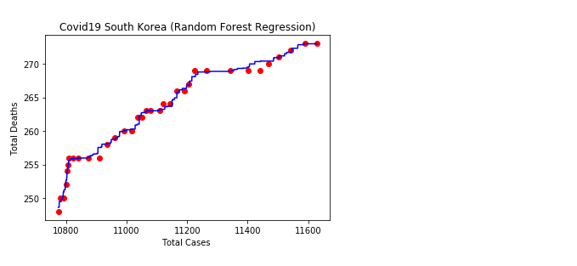
Practical part-Random Forest algorithm
South Korea
From 1st May – June
Accuracy: 94%

Slide 24
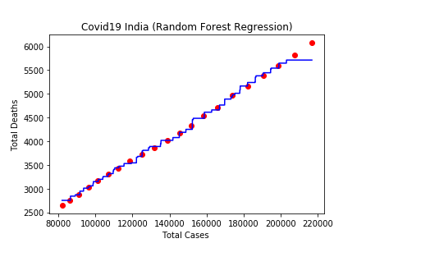
Practical part-Random Forest algorithm
India
From 15th May –June
Accuracy: 97.7%

Slide 25
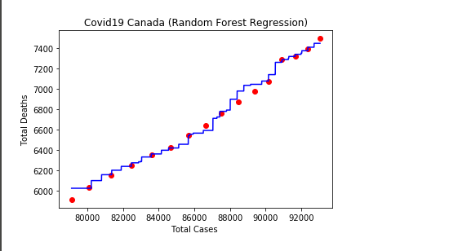
Practical part-Random Forest algorithm
Canada
Accuracy:
Starting from 1st May- June

Slide 26
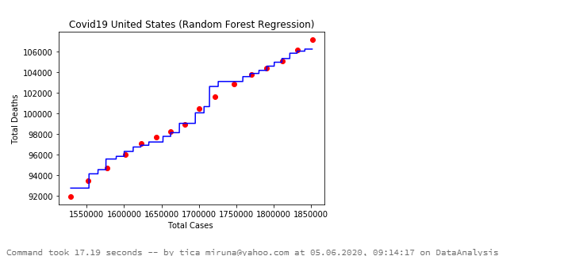
Practical part-Random Forest algorithm
United States
Accuracy: 95.7%
Starting from 20th May –June

Slide 27
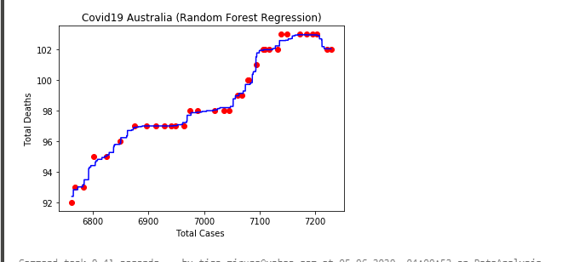
Practical part-Random Forest algorithm
Australia
From 1st Mat –June
Accuracy: 98.4%
Which is almost a good result because the total deathsand cases are constats almost and starting to decresing

Slide 28
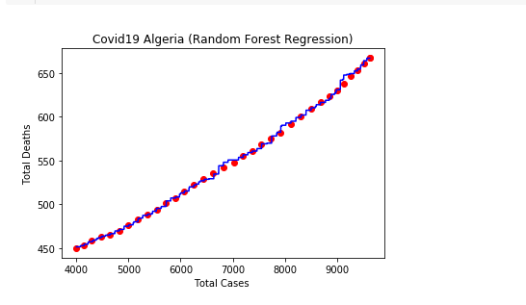
Practical part-Random Forest algorithm
Algeria
Accuracy: 98.7%
From 1st May –June
Same case as Australia

Slide 29
Results from Random Forest
As we can notice this model is not so suitable for every country that's why it might vary, or the starting days might vary or the nb. Of trees.
Spain, Germany and Alegria seems to be not the right countries for this algorithm.

Slide 30
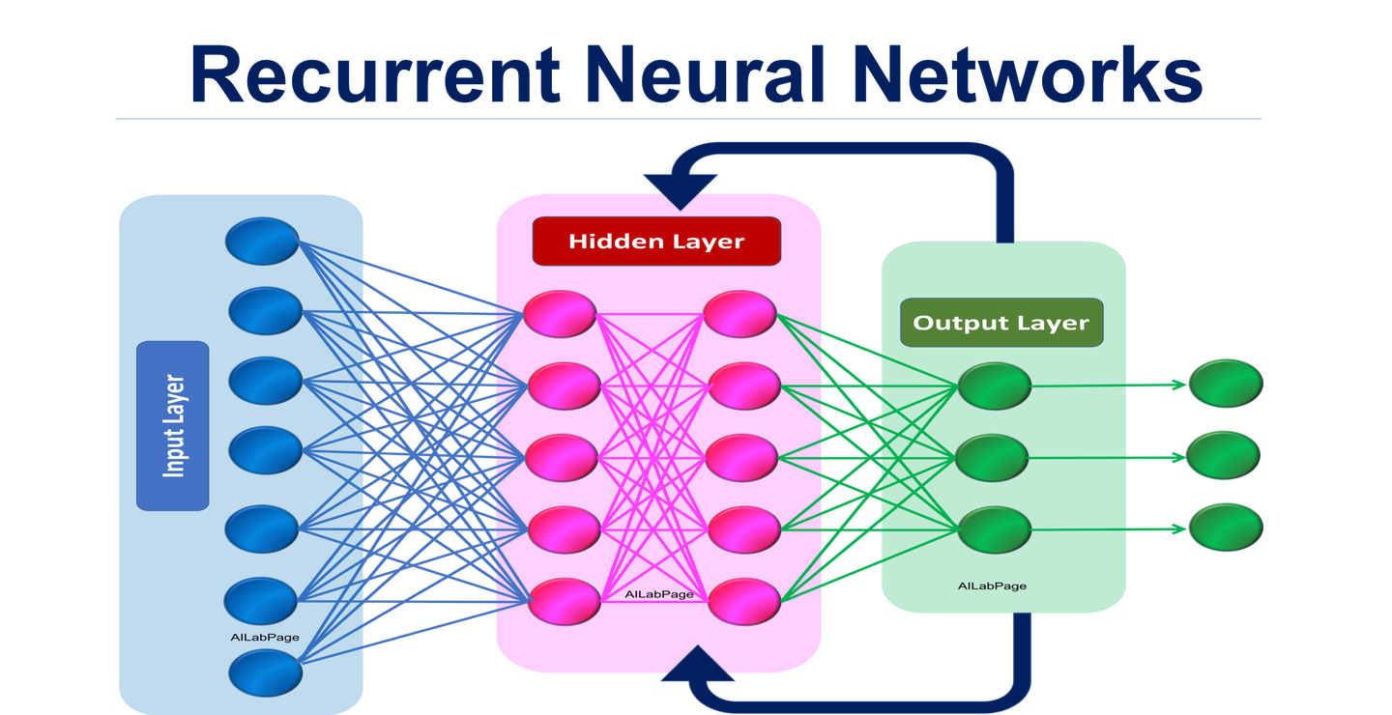
Theoretical part
RNN
RNNs are used to learn sequences and temporal patterns. They achieve this by having self-connections, the perceptrons are connected to themselves, along with feed forward connections. These two types of connections allow them to learn both recurrency and a non-linear decision boundary.

Slide 31
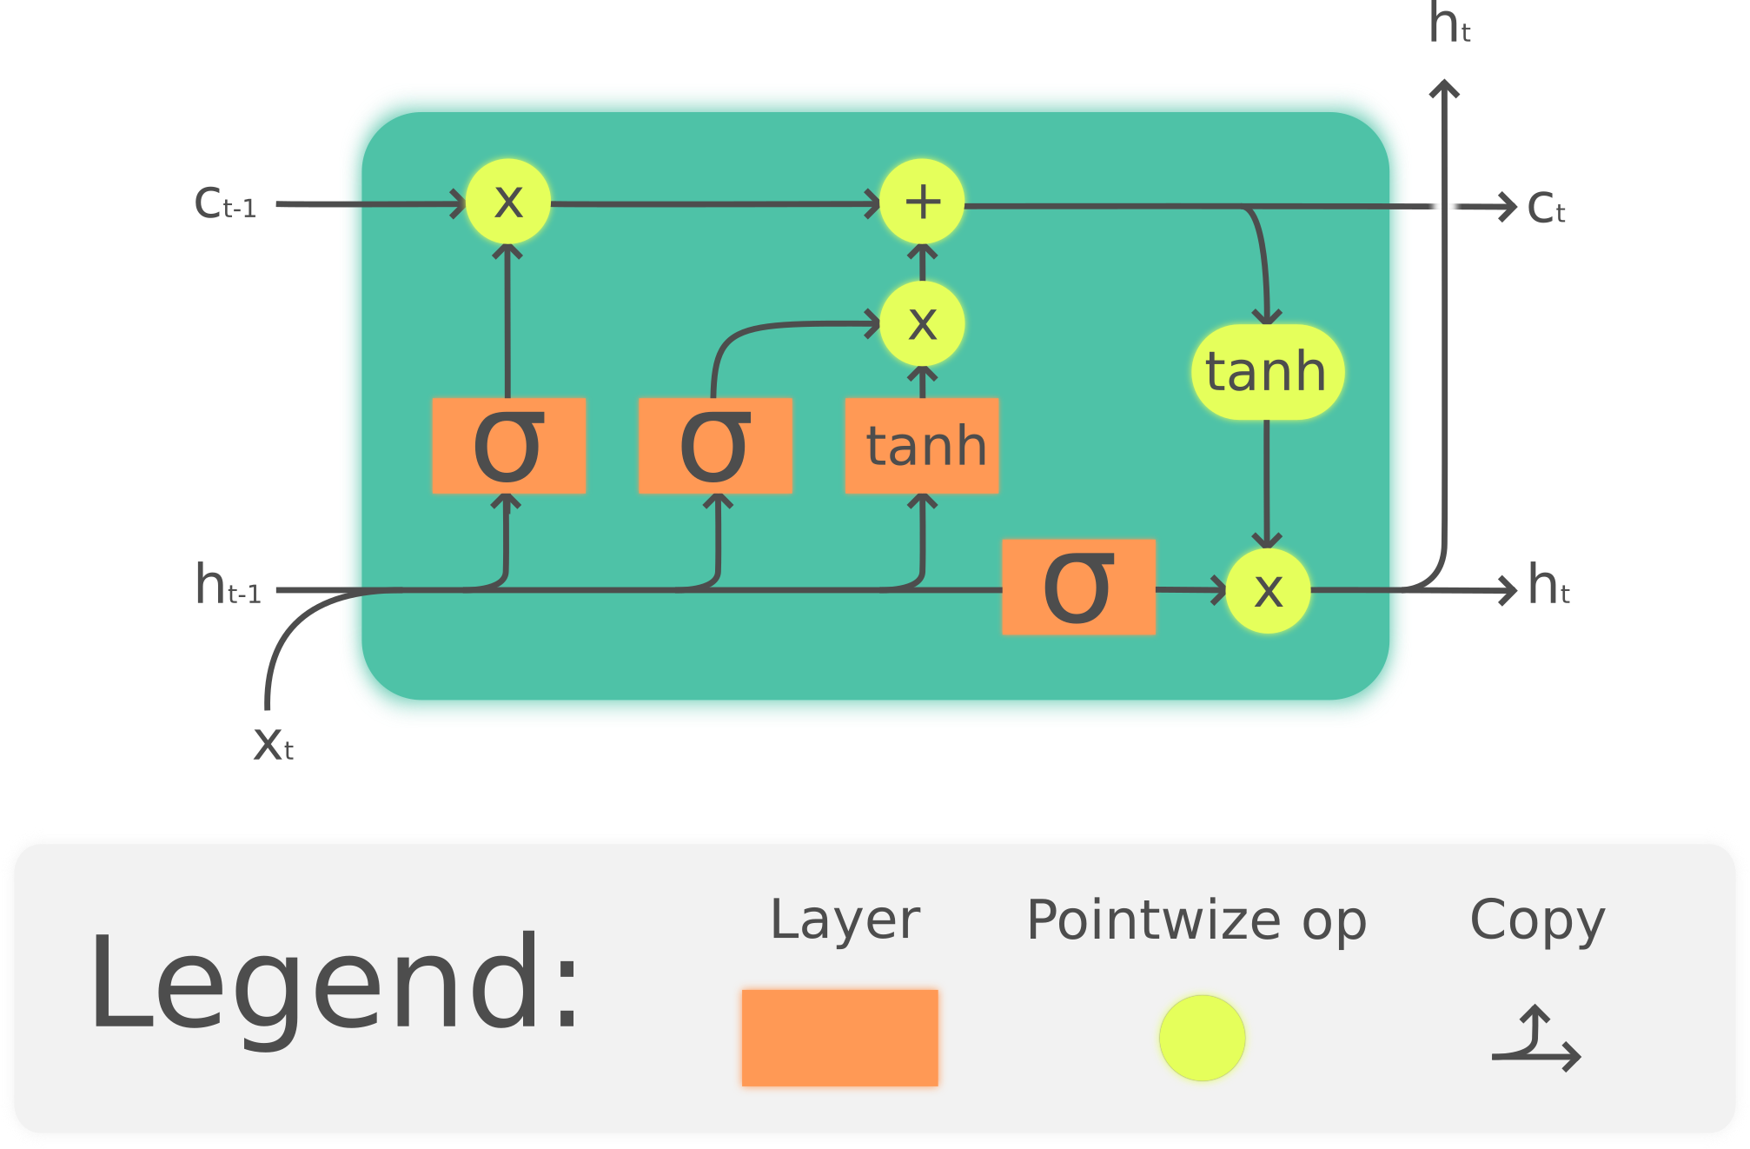
Theoretical part
LSTM(Long short-term memory)
LSTM is an artificial recurrent neural network (RNN) architecture^{[1]} used in the field of deep learning.
A common LSTM unit is composed of a cell, an input gate, an output gate and a forget gate. The cell remembers values over arbitrary time intervals and the three gates regulate the flow of information into and out of the cell.

Slide 32
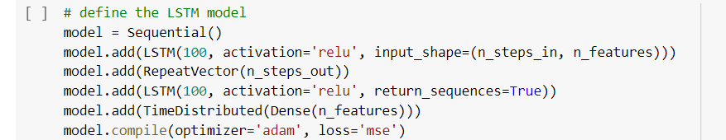
LSTM Model with Keras

Slide 33
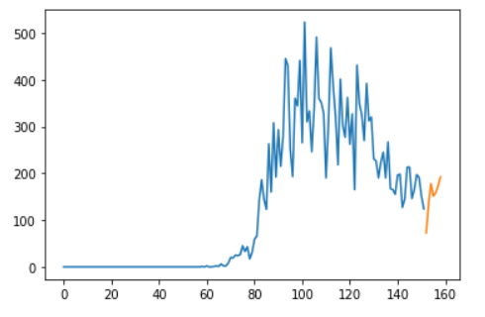
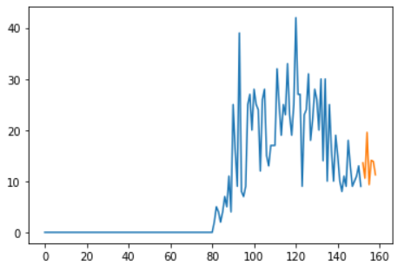
LSTM Forecast - Romania
dataset
prediction
New Cases
New Deaths

Slide 34
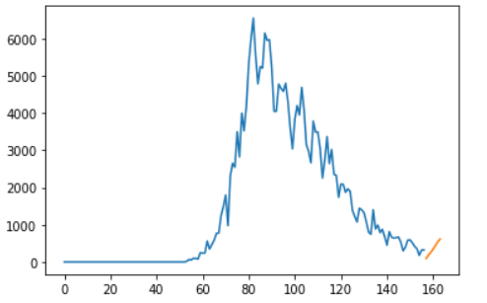
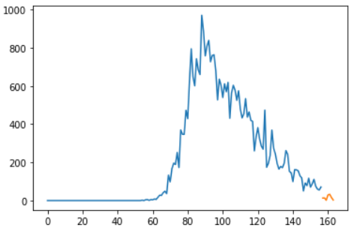
LSTM Forecast - Italy
dataset
prediction
New Cases
New Deaths

Slide 35
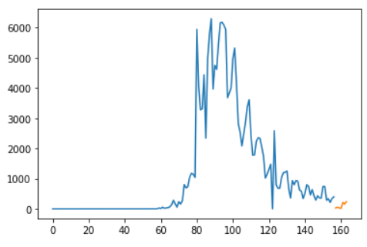
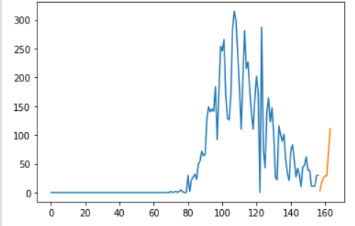
LSTM Forecast - Germany
dataset
prediction
New Cases
New Deaths

Slide 36
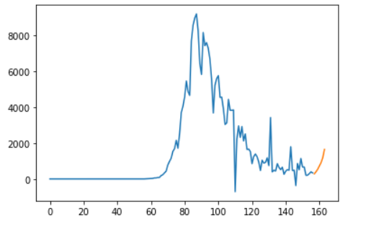
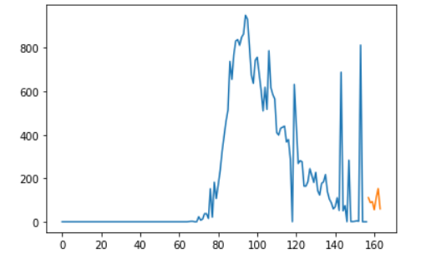
LSTM Forecast - Spain
dataset
prediction
New Cases
New Deaths

Slide 37
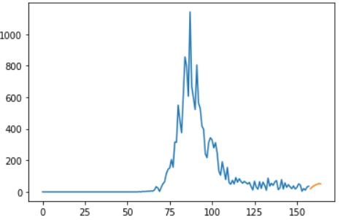
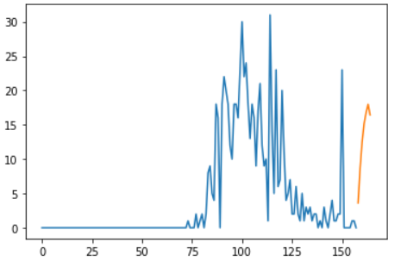
LSTM Forecast - Austria
dataset
prediction
New Cases
New Deaths

Slide 38
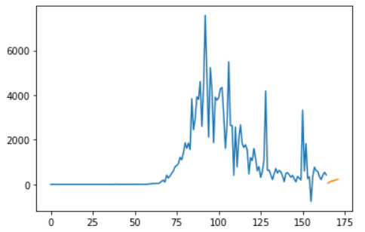
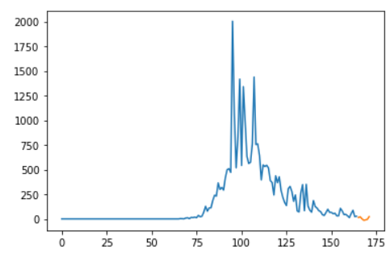
LSTM Forecast - France
dataset
prediction
New Cases
New Deaths

Slide 39
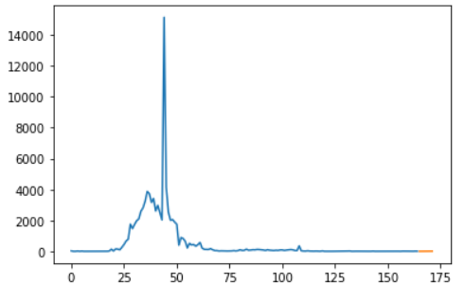
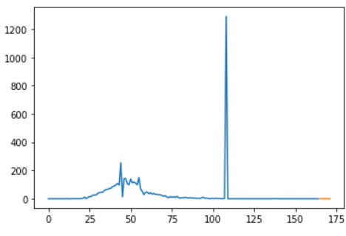
LSTM Forecast - China
dataset
prediction
New Cases
New Deaths

Slide 40
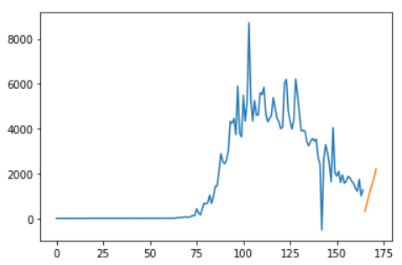
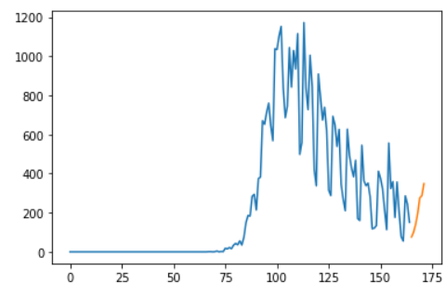
LSTM Forecast – United Kingdom
dataset
prediction
New Cases
New Deaths

Slide 41
Why RNNs over traditional NN?
As you know human beings don’t start their thinking from scratch at every second, i.e. you understand every word based on your previous word's understanding. Also, you don’t throw everything away and start thinking from scratch again. Your thoughts have persistence.
Traditional neural networks can’t do like this and it seems shortcoming. Suppose you want to know what kind of scene is appearing at every point in a film. It’s unclear how a traditional neural network could use its reasoning about previous events in the film to inform later ones.
Recurrent neural networks address this issue. They are networks with loops in them, allowing information to persist.

Slide 42
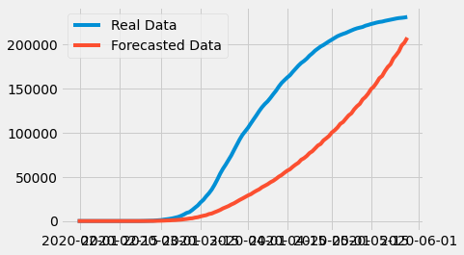
ARIMA Forecast – Italy
Total cases forecast:

Slide 43
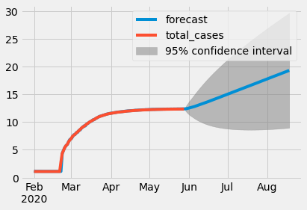
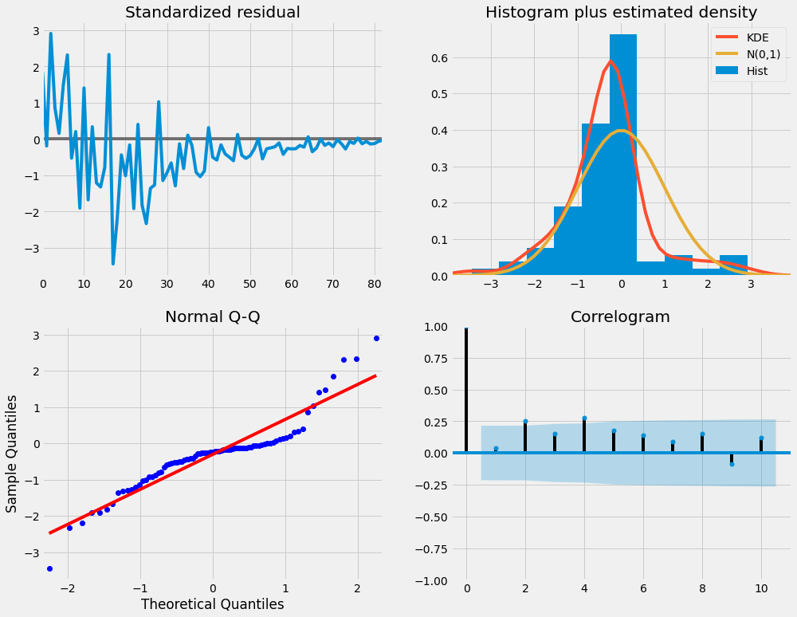
ARIMA Forecast – Italy

Slide 44
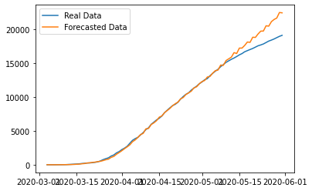
ARIMA Forecast – Romania
Total cases forecast:

Slide 45
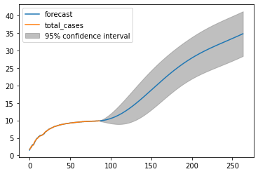
ARIMA Forecast – Romania

Slide 46
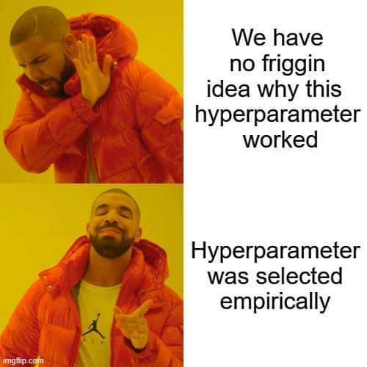

Slide 47


Slide 48
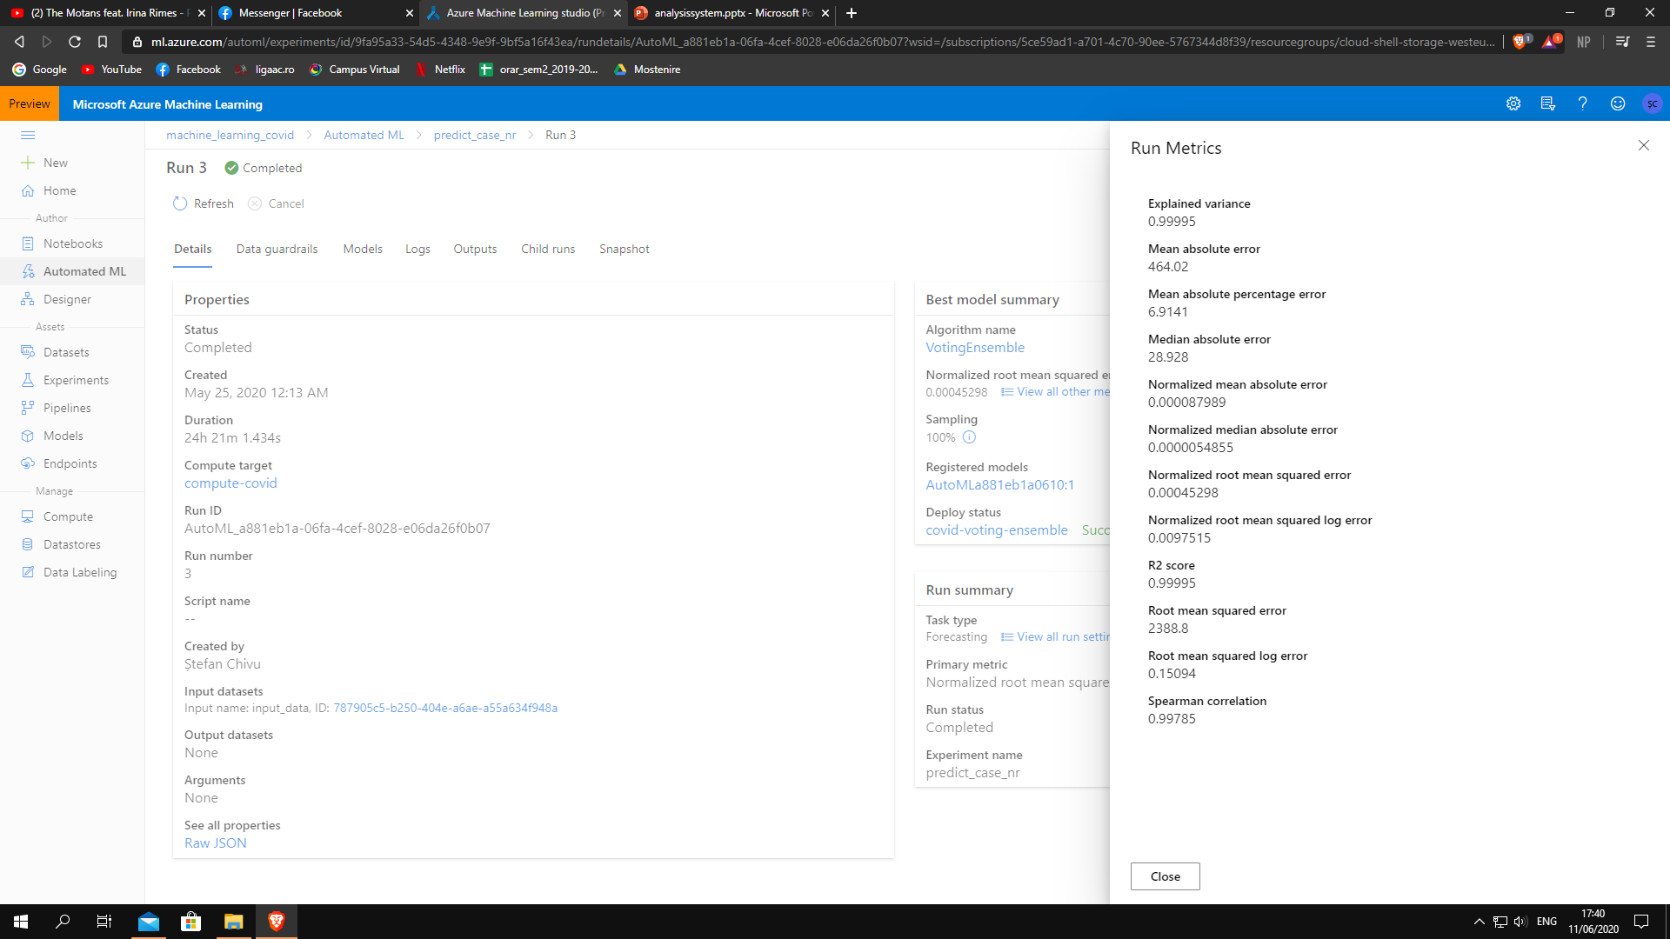



Experimenting with AutoML

Slide 49



Slide 50

Conclusions
In order for us to have a better prediction for this virus (COVID19) the best solution is to fusion our algorithms: Random Forest with LSTM and ARIMA , because nor for every country is suitable and also for the graph representation is Arima best represented. Why are we saying that not only one algorithm is the best one?
Well, because each country has a variational nb. of deaths or even cases, so not a single model is the right approch but a fusion of models.

Slide 51

Thank you!

